Slide 1
Machine learning integration in Earth observation projects at CRIM
Geosymposium 2019
Jean-Francois Rajotte
July 15th 2019

Slide 2
About
This talk
An overview of selected ongoing or upcoming EO-ML projects at CRIM
Most results shown are preliminary and their purpose here are to give application examples
Me
Data science researcher at CRIM
EO is a subset of my work
Soon starting a new position at the Data Science Institute of UBC
Will still stay an associated researcher at CRIM

Slide 3
Overview
CRIM
GeoImageNet
OGC Machine Learning testbed
MUSE
DACCS

Slide 4
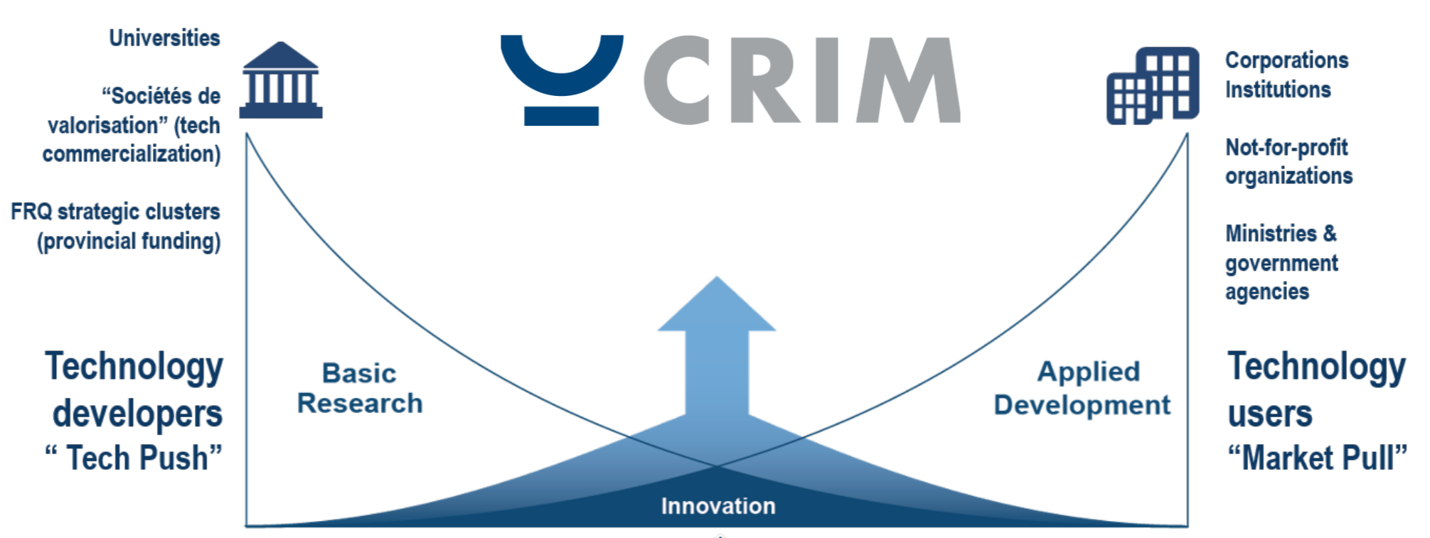

Computer Research Institute of Montreal
CRIM is a not-for-profit applied research center
In operation for more than 30 years
56 employees
80 to 100 projects, ~50 publications per year
With financial support from:
Notes:
Can also be flipped

Slide 5
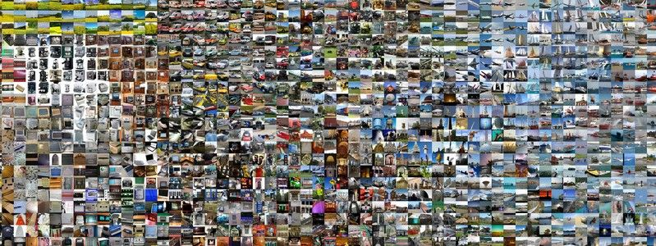



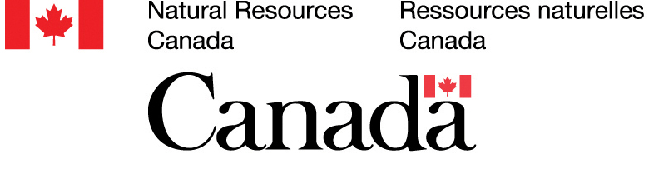
GeoImageNet
Motivation
ImageNet
14 million images
20k categories
Taxonomie based on WordNet hierarchy
Enabled great improvements in deep learning for computer vision
Goals
Create an open platform allowing collaborative annotation of geospatial data
Create a large annotated dataset
Platform to share data, models and evaluation services
In operation late 2019
Notes:
Production of taxonomies for EO optical data for Land cover classes and objects.
Offers an API to access and run trained models.
Taxonomy : classification

Slide 6
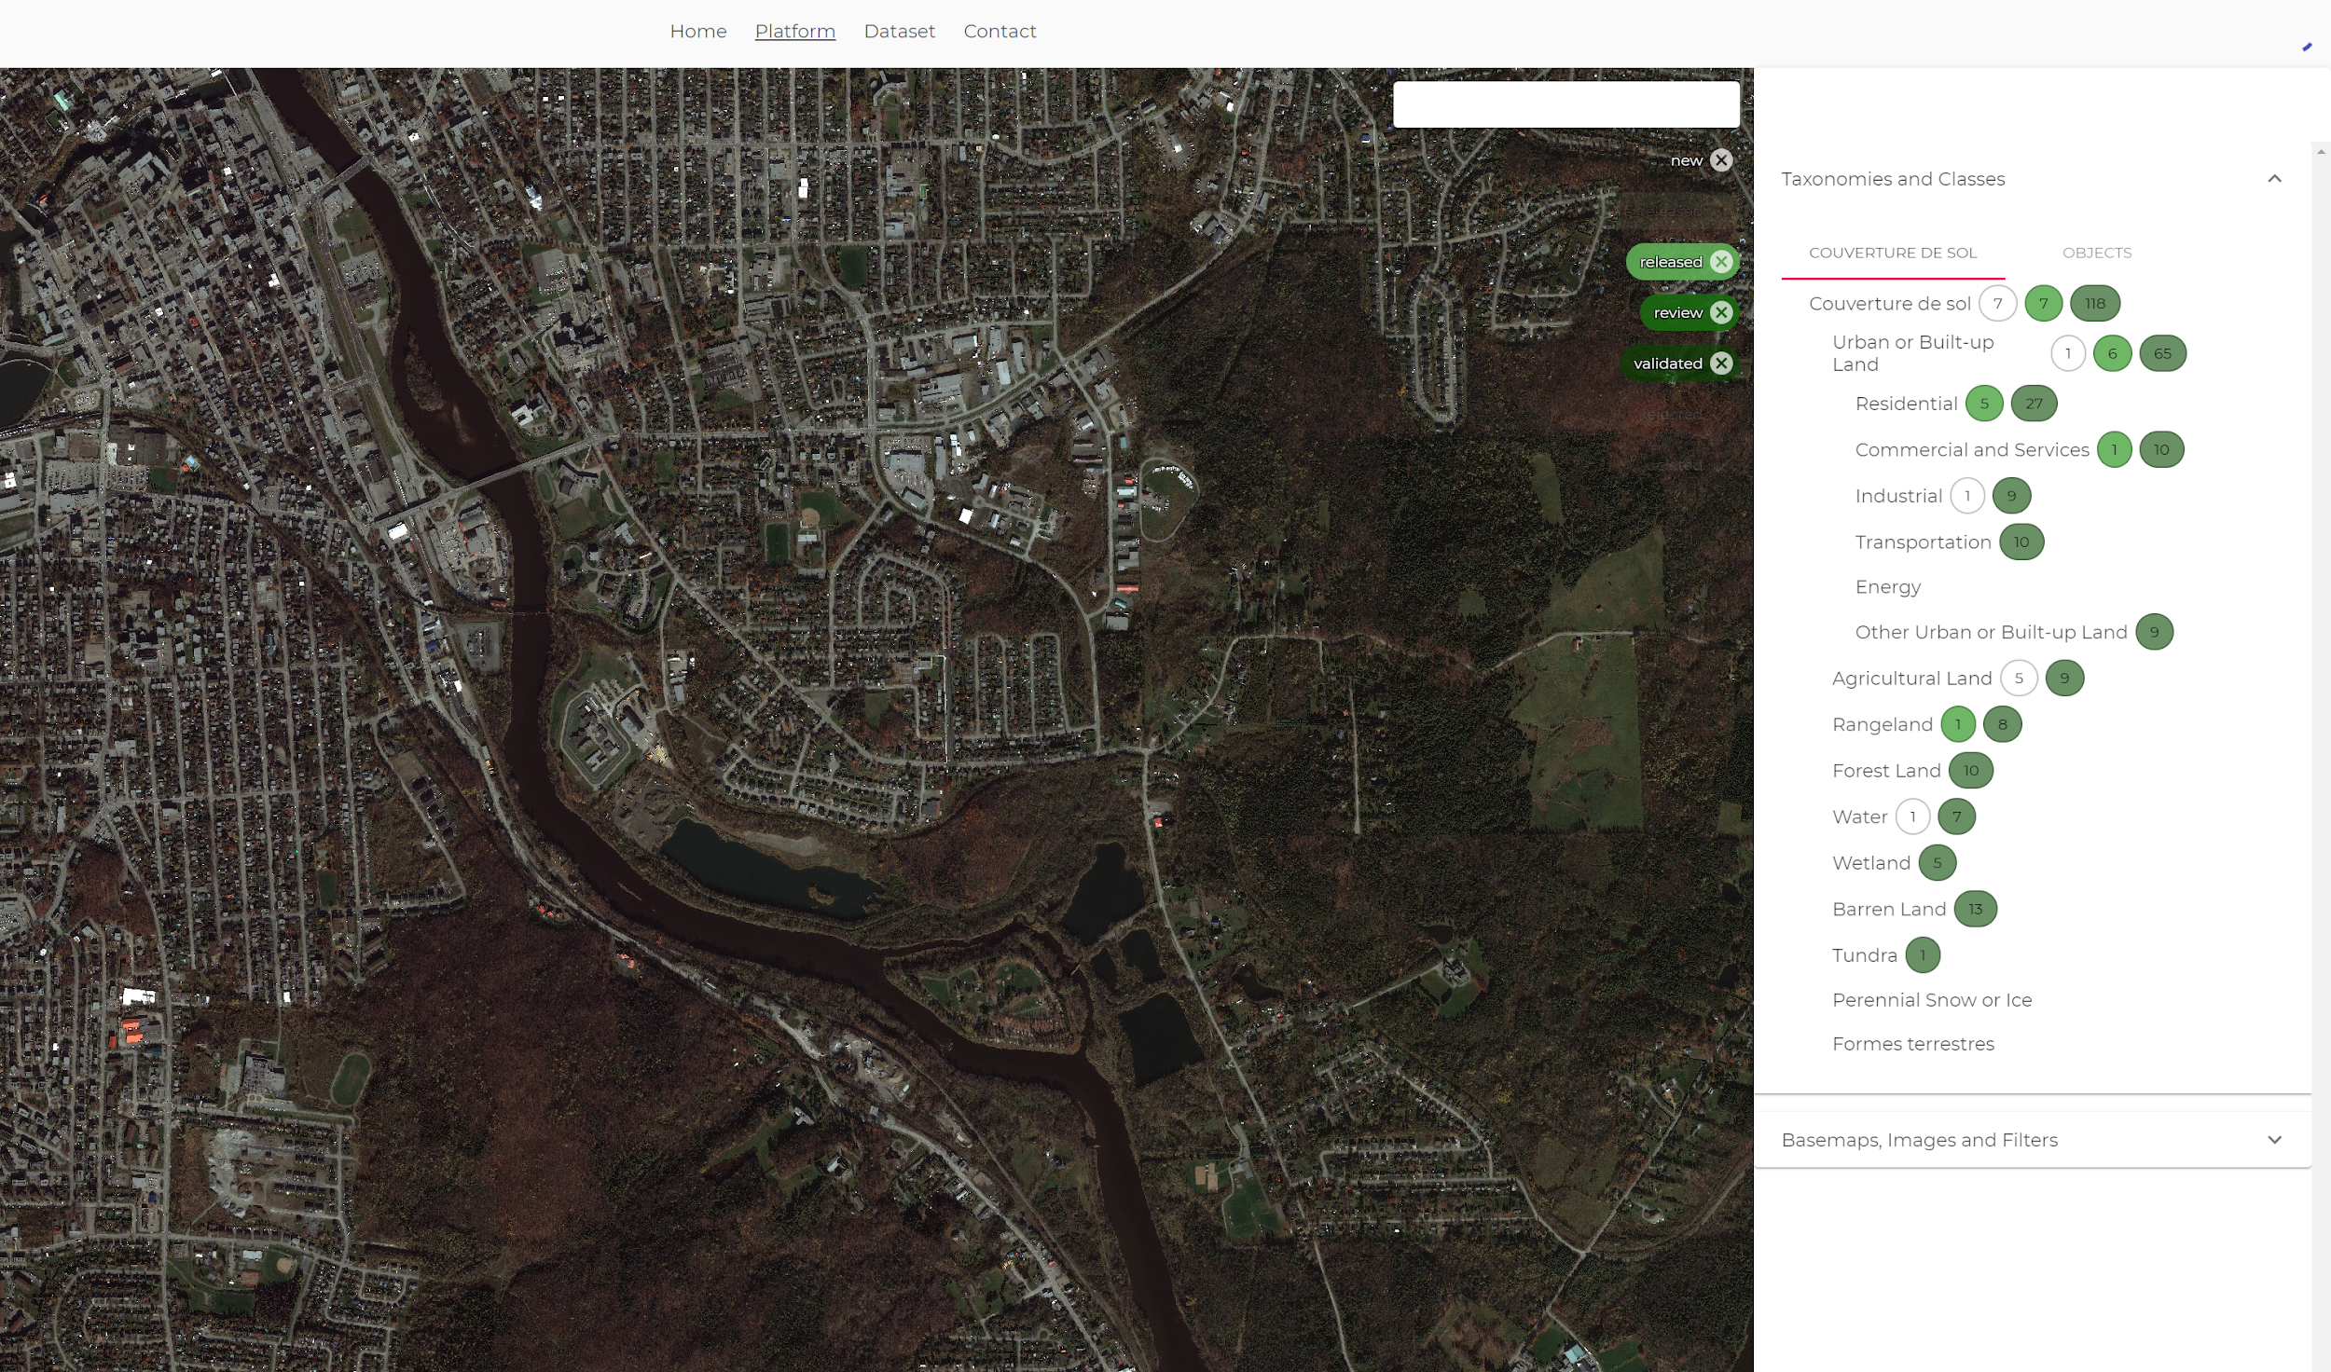
GeoImageNet
Notes:
Annotation of data by specialists.

Slide 7
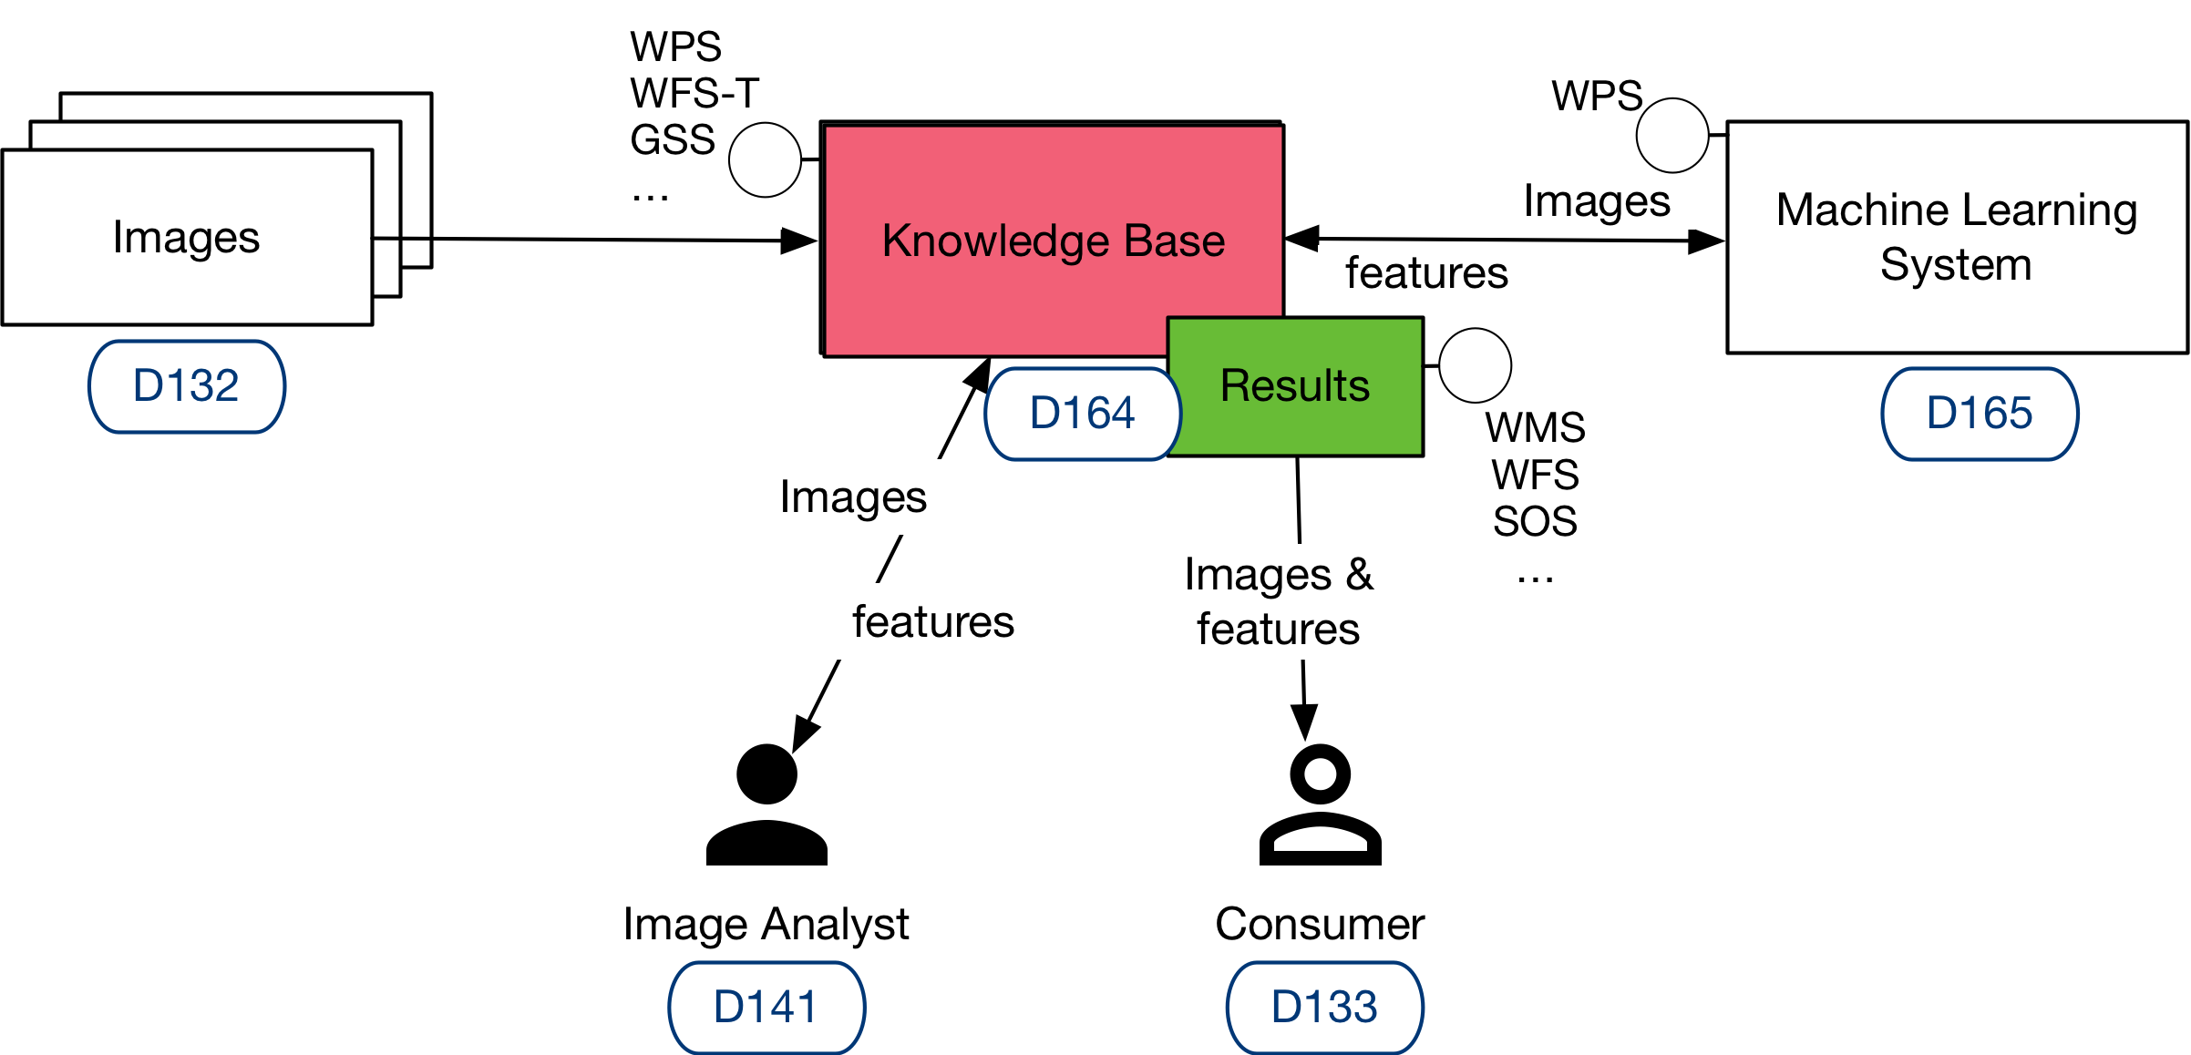



OGC Machine Learning Testbed
Goal:
To present a holistic approach on how to support and integrate emerging AI tools using OGC Web Services
ML
training
execution
Knowledge base
Models
Data
Features
Metadata
Semantic enablement
search
Sponsors
Notes:
Determine the requirements of each services
then put them together in a proof of concept
http://docs.opengeospatial.org/per/18-038r2.html#_main_findings
WPS : web processing Service
Interoperabilité
Separate deliverable : specification
Demo put everything together

Slide 8
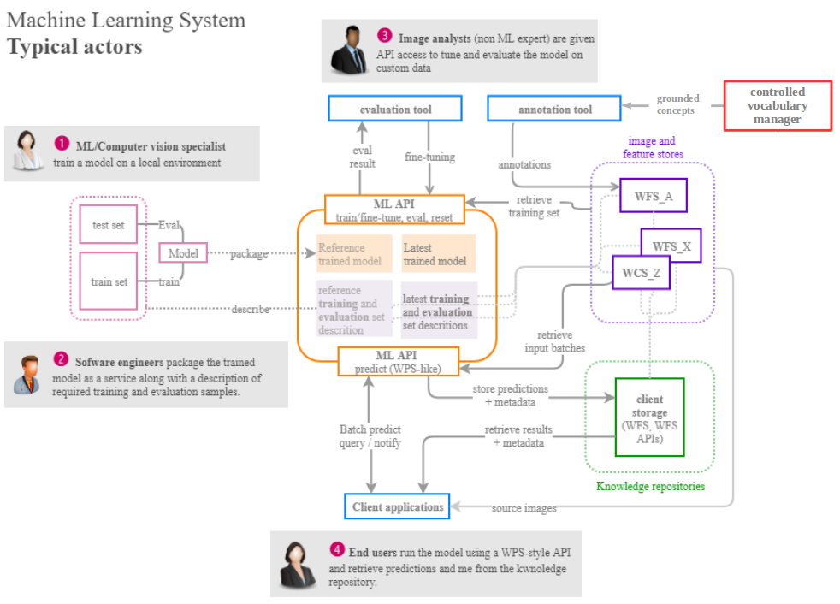
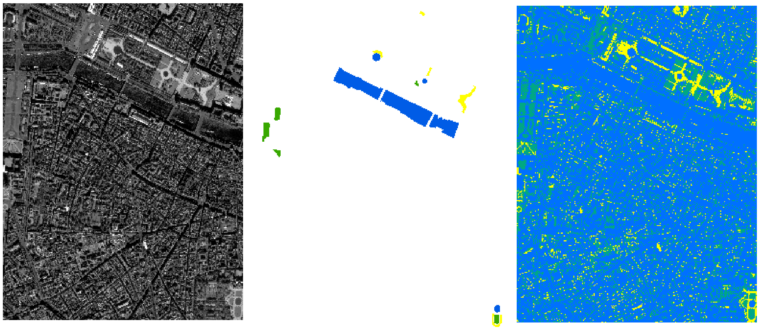
OGC Machine Learning Testbed
Proof of concept
Source
Training
Output
Notes:
Scenario : disaster like flood
Model = decision tree
http://docs.opengeospatial.org/per/18-038r2.html#poc
http://docs.opengeospatial.org/per/18-038r2.html#ExampleClause
http://docs.opengeospatial.org/per/18-038r2.html#_semantic_interoperability

Slide 9
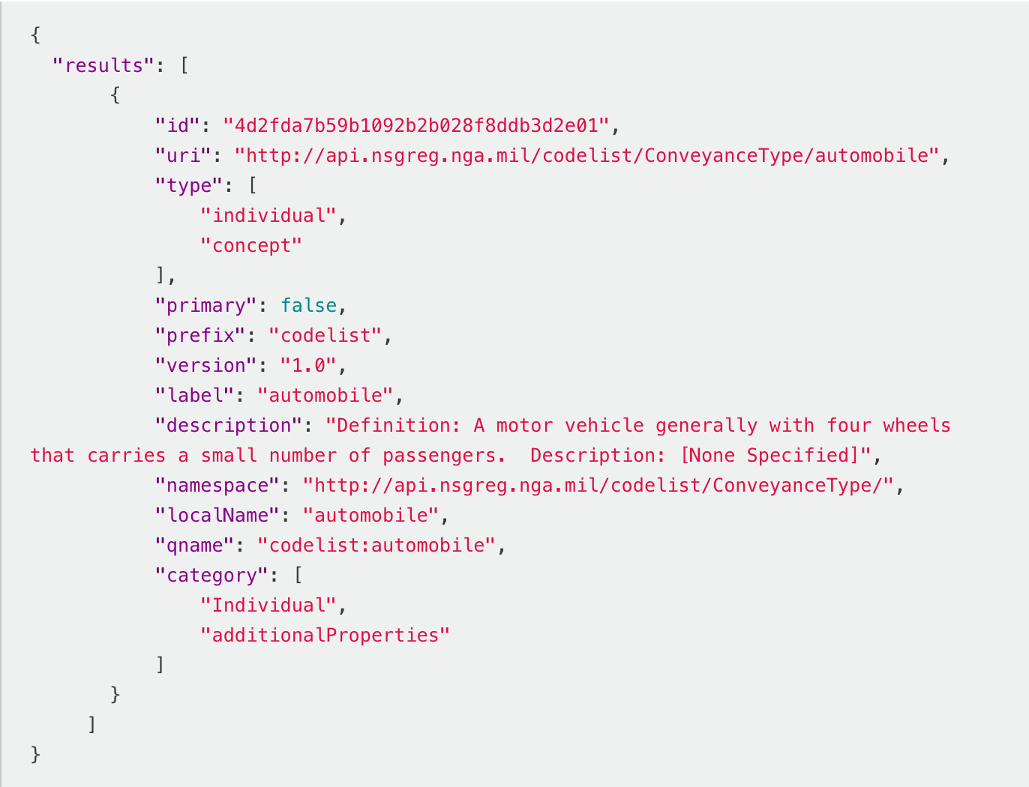
OGC Machine Learning Testbed
Semantic enablement of ML
Extensible, unified ontology for structured observations as a semantic enrichment service
Query example : automobile
Semantic interoperability
Controlled vocabulary manager:
Provides a common vocabulary to all components within the architecture.
Future work :
Query interpreter (NLP)
Include experiments on automatic generation of workflows or selection of catalogues workflows taht are closest to a user query
Notes:
http://docs.opengeospatial.org/per/18-038r2.html#_d166_semantic_enablement_of_ml
http://docs.opengeospatial.org/per/18-038r2.html#_semantic_interoperability

Slide 10
OGC Machine Learning Testbed
Challenges : shared knowledge
Recommendations for future work :
Advance semantics enablement : ”identify standardization needs for transforming data into knowledge“
“Provide an OGC Catalogue service” interface as a standardised interface into the knowledge base
Integrate the Controlled Vocabulary Manager into the existing tesdbed architecture
Query interpreters & query conductors
Notes:
http://docs.opengeospatial.org/per/18-038r2.html#_recommendations_for_future_work
http://docs.opengeospatial.org/per/18-038r2.html#_semantic_interoperability

Slide 11
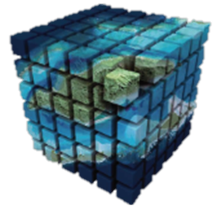
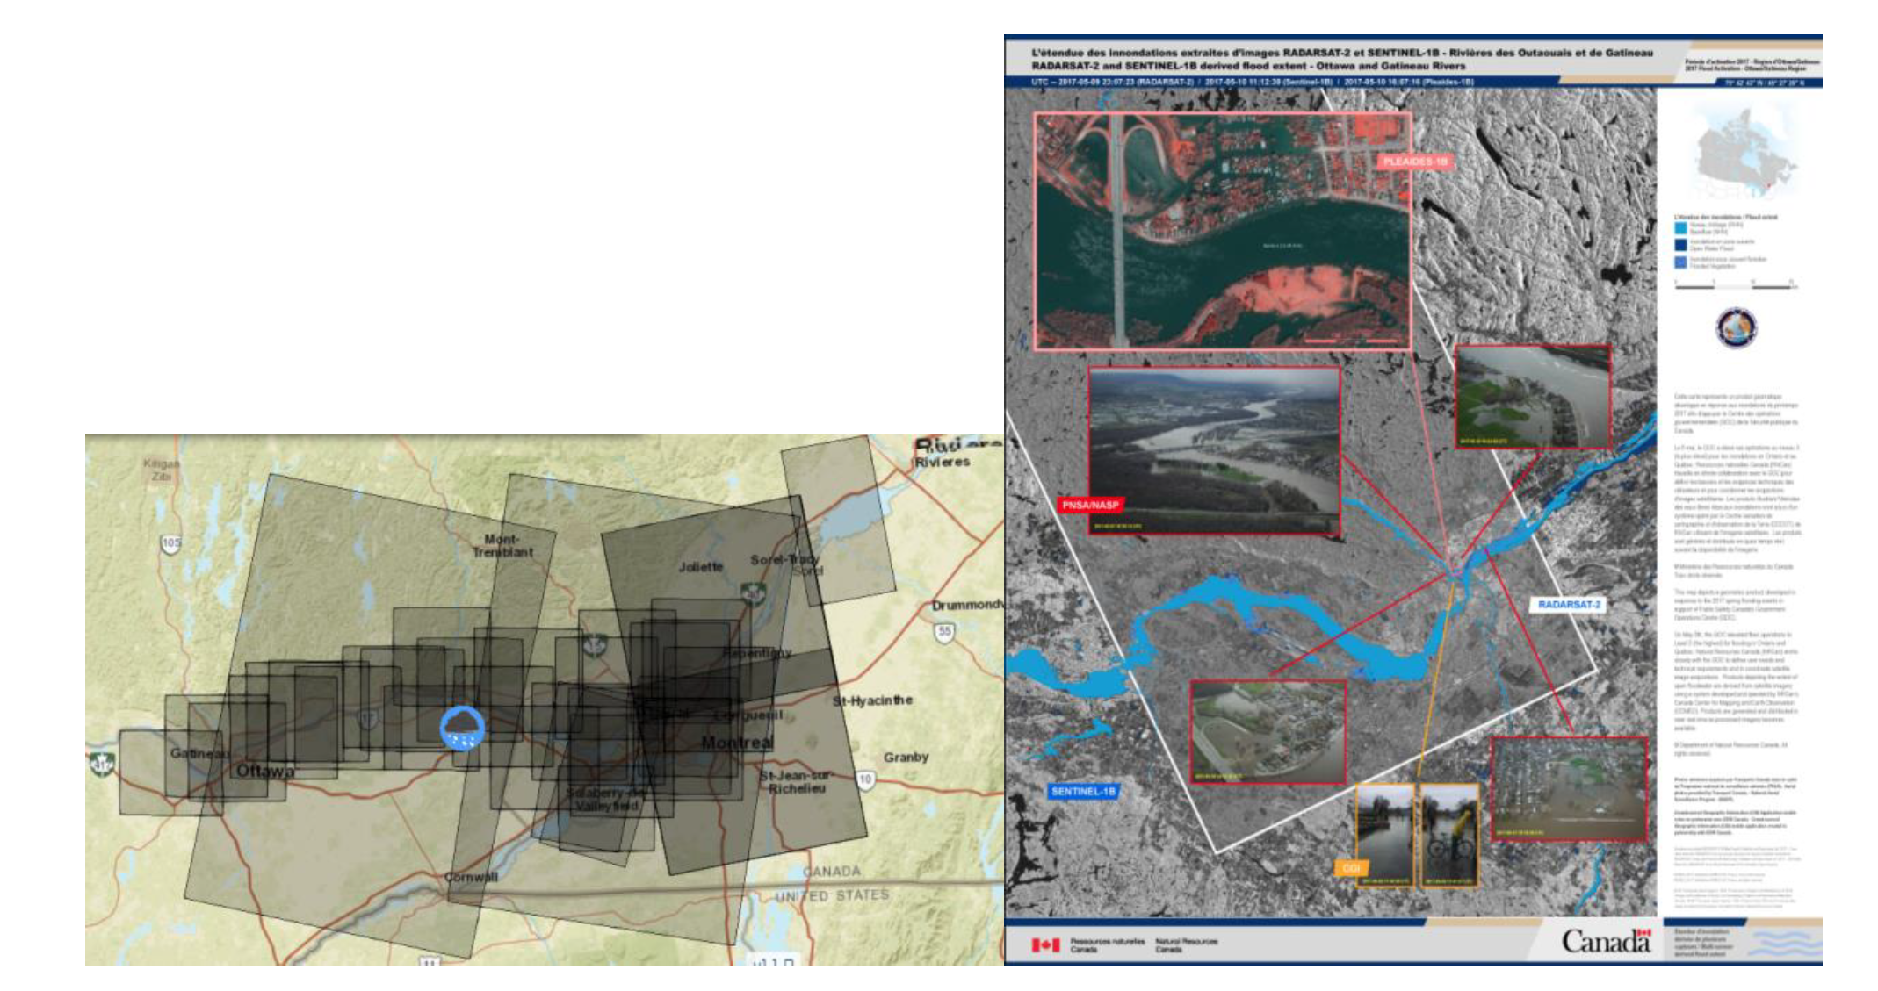
MUSE
Goals
Provide institutional users a powerful chain able to process big multi-sensor data in near real-time
Integrate RADARSAT together with other EO data and enhance processing technologies
Axes
Optimized system architecture based on open source
Optimize processing time
Processing and production of data
Use case
2017 flood in Quebec, Canada
Notes:
This project just started
https://drive.google.com/file/d/1UnvIlToYqazK7AiRZBIxYe5y5VxWarqm/view?usp=sharing

Slide 12
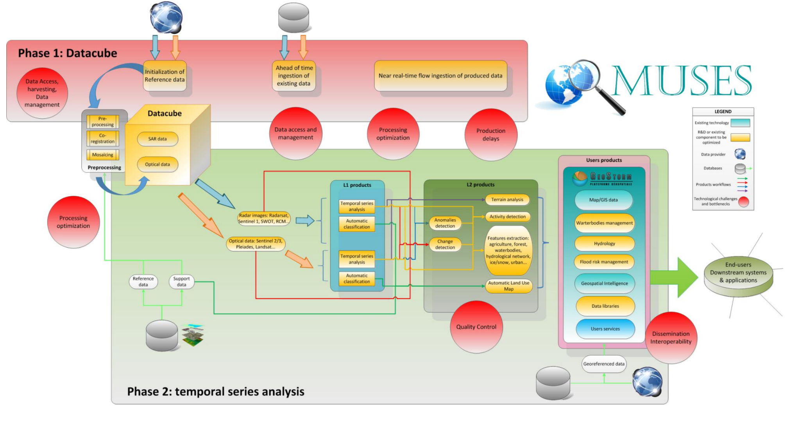
MUSE
Notes:
Ingestion should be done with the main use in mind : projection, partition...

Slide 13
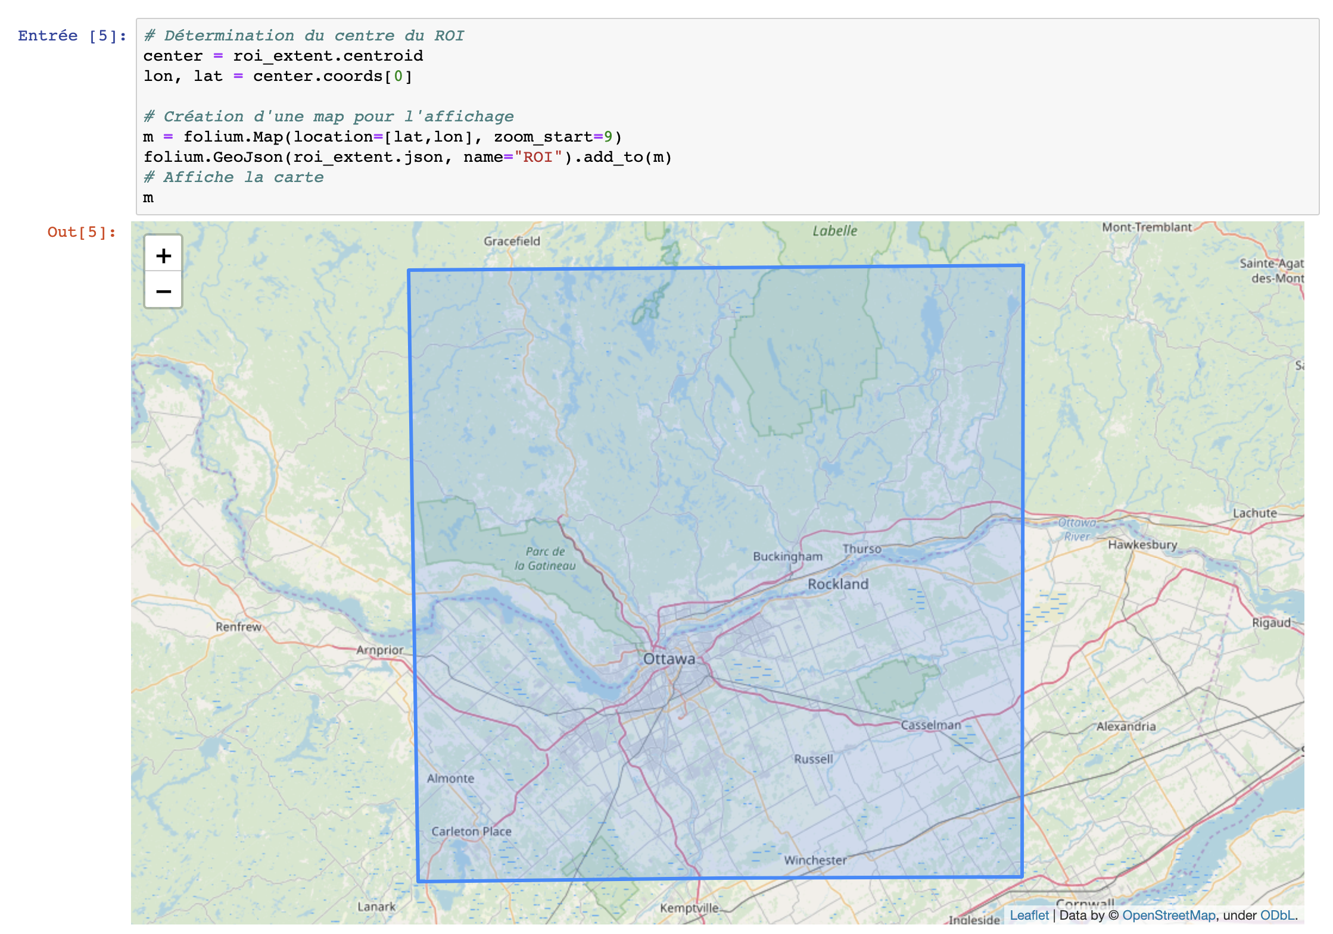

MUSE
Open Data Cube
An integrated gridded data analysis environment
for analysis ready earth observation data
Multi-sources
Exploratory analysis
Large-scale workflow
Using Jupyter notebooks

Slide 14
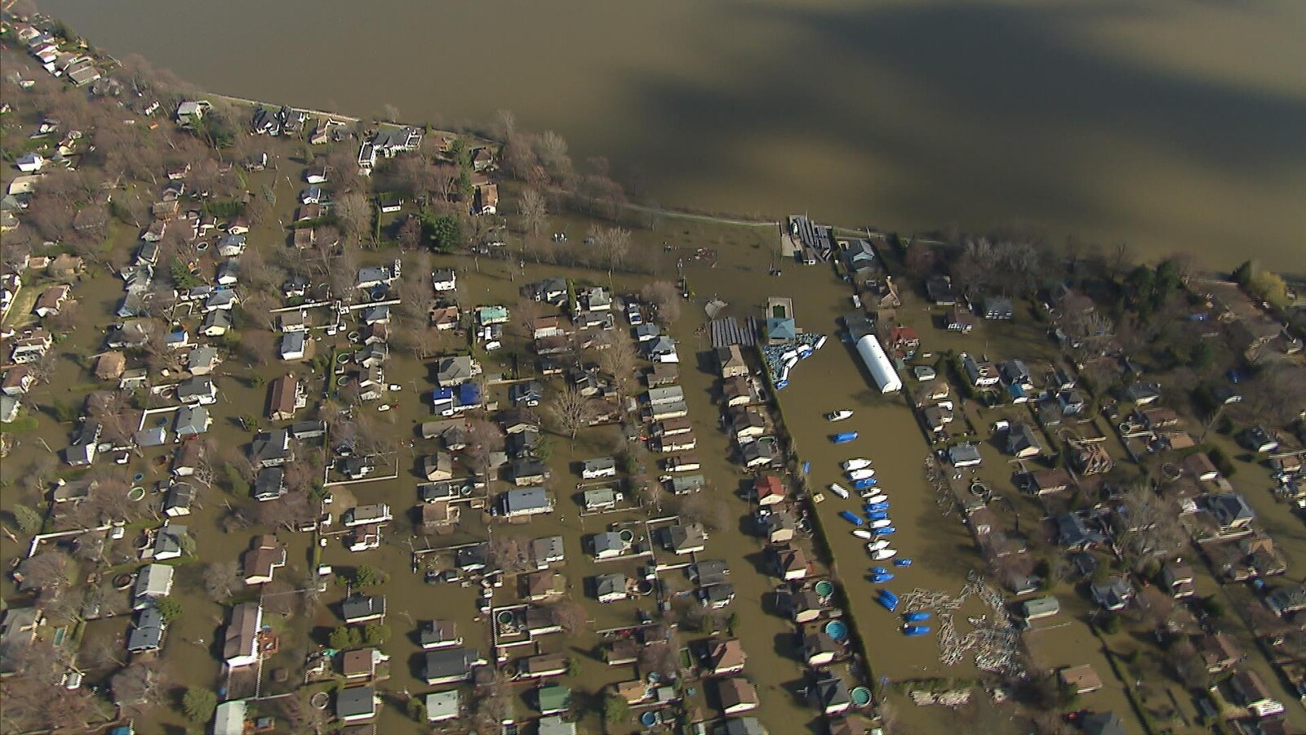
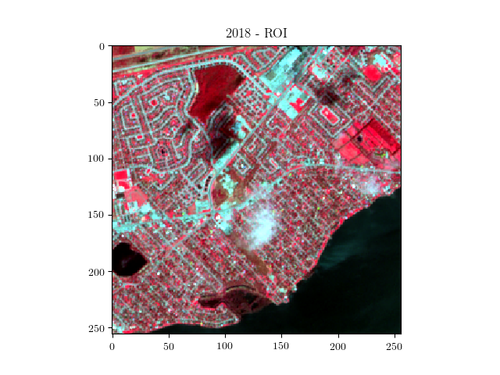
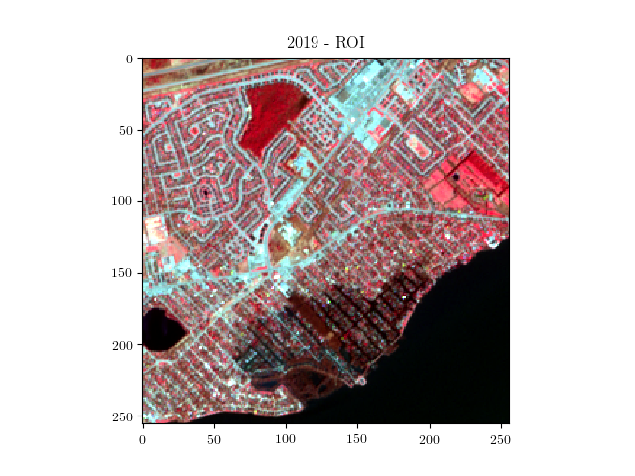
MUSE
Sainte-Marthe sur le lac, flood of spring 2019
Sentinel-2 (2018-05-11)
Sentinel-2 (2019-05-06)

Slide 15
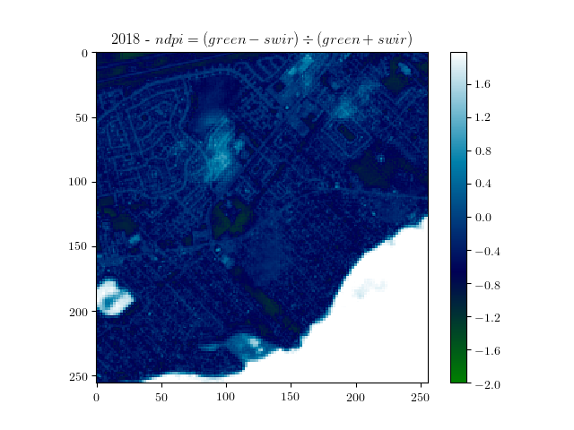
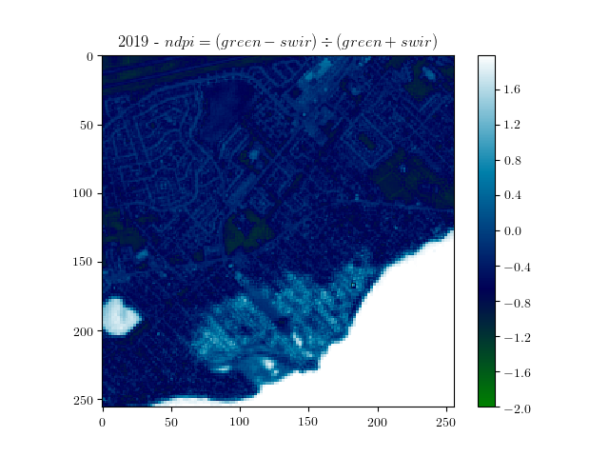
MUSE
Sainte-Marthe sur le lac, flood of spring 2019
NDPI Computation
Water detection
NDPI = (B3 - B11) / (B3 + B11)
B3 (S2 Green Band) (10 m)
B11 (S2 SWIR Band) (20 m)
Notes:
Normalized Difference Pound Index

Slide 16
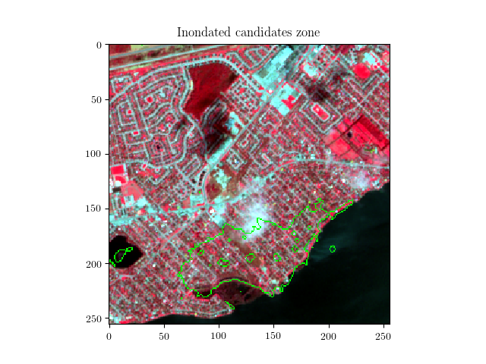
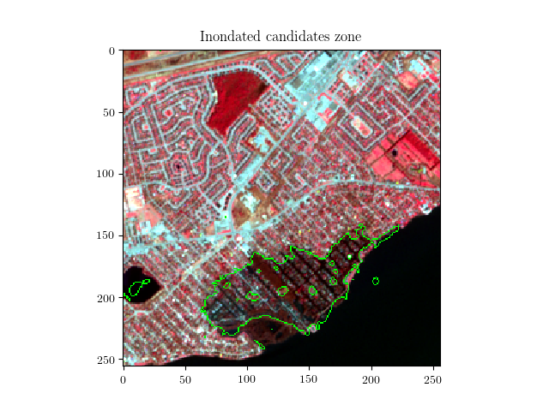
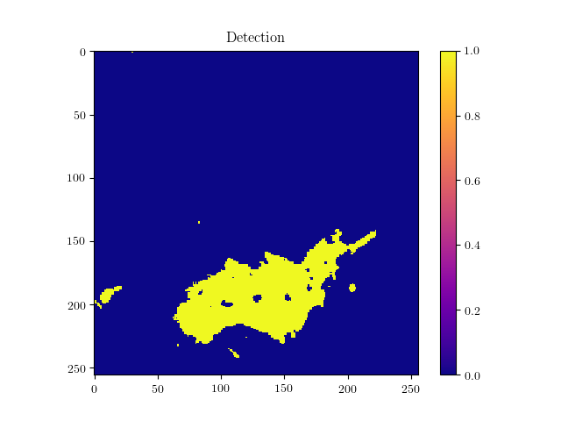
Polygonize
Image Sentinel-2 (2018-05-11) NRG
Image Sentinel-2 (2019-05-06) NRG
NDPI changes mask

Slide 17
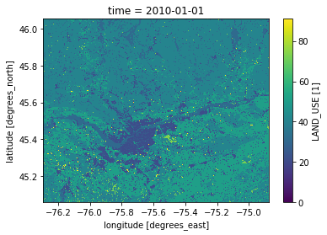
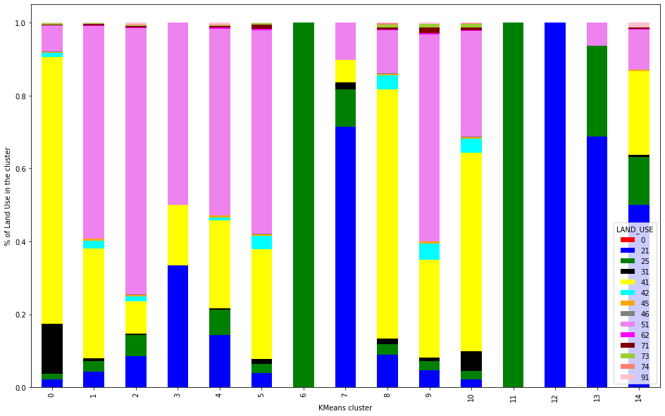
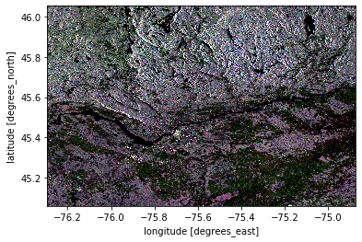
MUSE
Unsupervised clustering related to land use
Fraction of land use within unsupervised cluster
Land Use
% of land use
Sentinel 1
Clusters
sentinel 2 (not shown)
Preliminary exploration with 100m resolution
Notes:
Not expected to have a one-to-one relation, but ideally a combination of unsupervised clusters could correspond to a land use

Slide 18

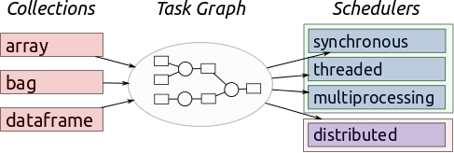
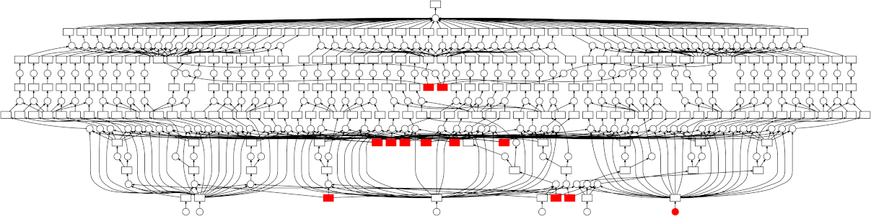
Muse
Big data
Losing infrastructure abstraction:
Need to know your infrastructure
Decide the data partitioning based on the data, the infra and the usage
More optimization trick with assuming the user’s intent (ex: projection)
→ more complex API
Distributed computing

Slide 19









DACCS
Data Analytics for Canadian Climate Services
A workflow-based science Gateway (virtual laboratory).
Adds new climate services and applications to ESGF:
Sea ice from observations and model simulations
C02 and methane concentration measurement
Climate extremes and cyclone tracking
Coastal vulnerability analysis
Deep Learning-based Land Cover Mapping
EO Datacube
Kickoff in September 2019
Funded by:
Notes:
A comprehensive climate data analysis tool
https://docs.google.com/presentation/d/1Gk3wcG4BcwdNFsa-CM1hXcdqcVMoaFs409gax08wvvI/edit?usp=sharing

Slide 20
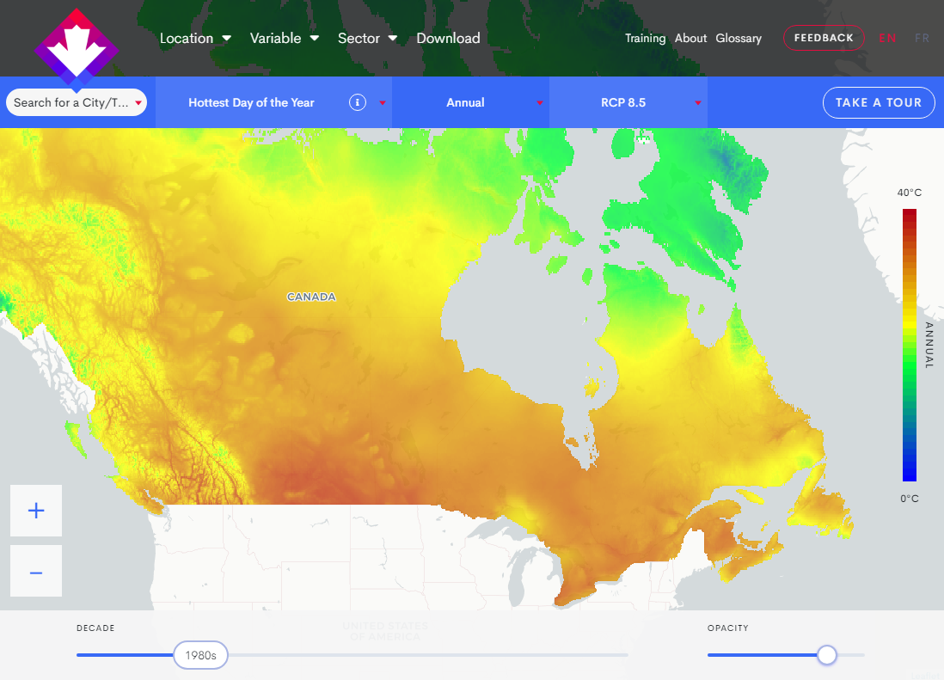
DACCS
Climate data portal
Public portal for DACCS
Collaborative development of Canadian Center for Climate Service lead by CRIM
Launched June 2019
climatedata.ca
Notes:
Mostly Temp and precipitation for now
Regional climate services consortia are partners of Canadian Center for Climate Services (CCCS), and new consortia are being fostered.
Collaborative development of a Canadian climate data portal led by CRIM. Launch June 2019.
CCCS welcomes collaboration with countries sharing needs for user-driven climate services for population, indigenous or remote communities.

Slide 21
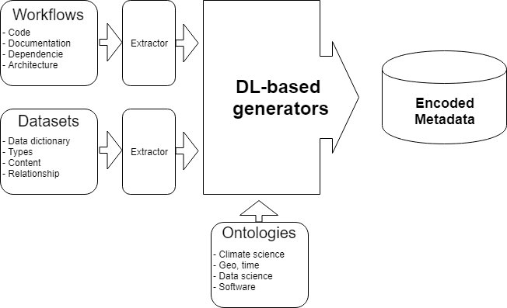
DACCS
Natural Language Understanding tools
Metadata generation
Convert and encode resources available into queryable form of metadata
Ressources
Workflow
Dataset
Ontology
ML-based
generator

Slide 22
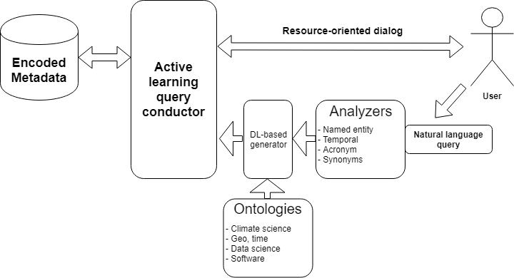
DACCS
Natural Language Understanding tools
User-oriented query alignment
Enrich and transcode the user query with knowledge resources to guide the query process on the encoded metadata
Ressources
Query : natural language
Ontologies
Algorithms (to interpret the query)

Slide 23
Conclusion
This has been an overview of few EO projects at CRIM. We are still thinking about ways to adresse the sharing of data, features and concepts betweens components of our workflow. Data semantics is definitely a key element here. We need to know what are the best practices to help get in the right direction.

Slide 24
End

Slide 25
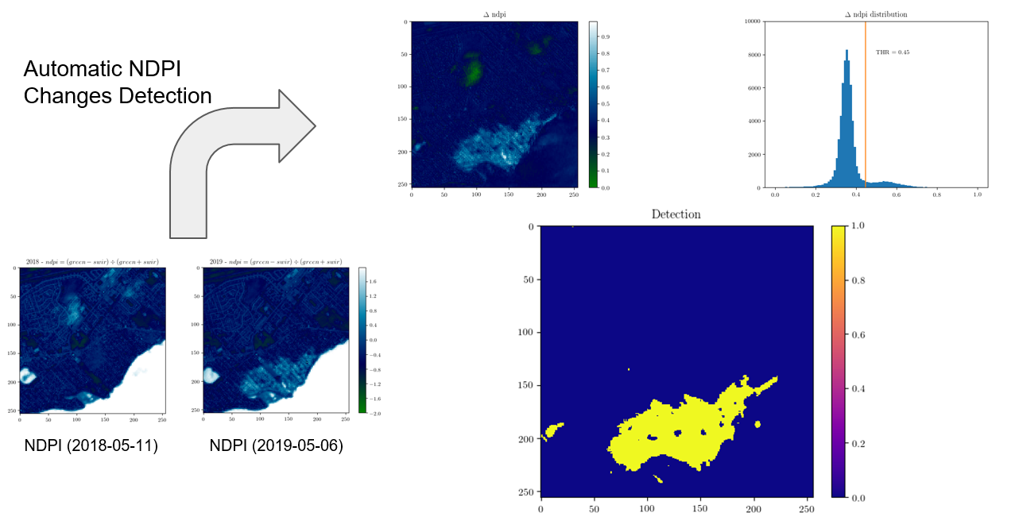
Thresholding

Slide 26
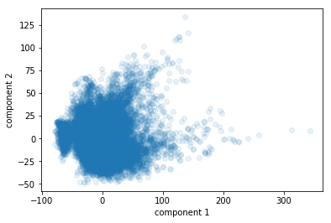
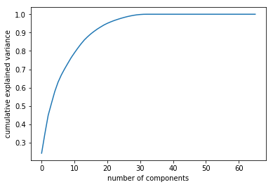
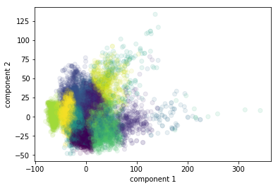
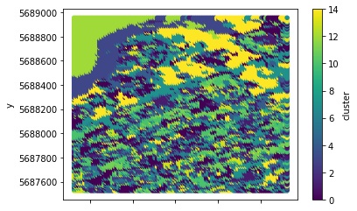
Simple unsupervised land classification
Dimension reduction, ex: PCA
Explained variance
Visualization
Classification

Slide 27
Links
GeoImageNet
Production of taxonomies for EO optical data for Land cover classes and objects.
Annotation of data by specialists.
Offers an API to access and run trained models.
OGC Machine Learning testbed
Best practices for using OGC web services to deploy ML apps in Cloud environment. Introduction of model execution, training and retraining in form of an API. Use of workflows.
Proof of concept of an annotation system linking labelled data to trained models
Introduction of Common Architecture concepts for federated infrastructures
MUSE
Use of a datacube to provide data for land cover mapping and change detection.
Land cover classes are geosemantic.
DACCS
Challenge is linking EO and climate taxonomies. One way is through indexation of Workflows, Data and Apps. Use of ML tools to produce classifications, like GeoImageNet. Plan to build NLP Query expansion and Active Learning.

